Slide 1
Intrusion Detection System Using Deep Neural Network for In-Vehicle Network Security

Slide 2
Intrusion Detection System using Machine Learning
Deep Belief Network
Detection Phase and Training Phase
Extracting Feature in CAN Packet
Training and steps to Peform DNN
Attack Detection

Slide 3
A novel intrusion detection system (IDS) using a deep neural network (DNN) is proposed to enhance the security of in-vehicular network.
The parameters building the DNN structure are trained with probability-based feature vectors that are extracted from the in-vehicular network packets
It uses techniques such as initializing the parameters through the unsupervised pre-training of deep belief networks (DBN).

Slide 4
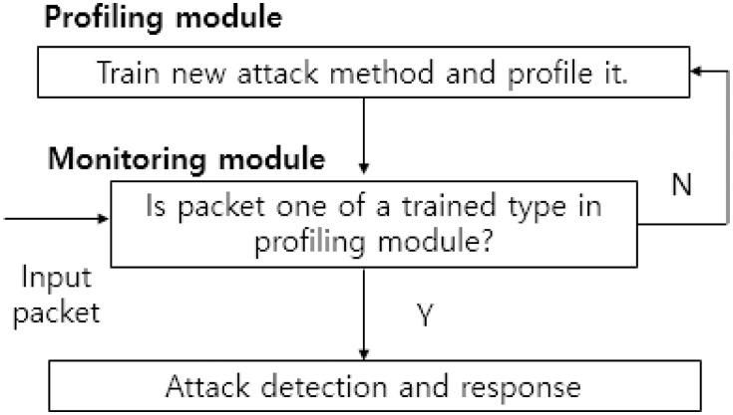
Intrusion Detection with Machine Learning
Notes:
An unsupervised machine learning technique such as a self-organized feature map (SOM) for network intrusion detection is proposed instead of frequency-based encoding method which is used for a packet feature in ANN and SVM.
Figure shows a common architecture of the IDS based on machine learning. The IDS includes various modules for gathering and analyzing a large amount of data packets. Typically, the monitoring module detects a type of an incoming packet after feature extraction. The profiling module contains the features trained off-line. If the monitoring module identifies a new attack type, the profiling module may update the database of the profiling module for upcoming packets.

Slide 5
The deep belief networks (DBN) as a probabilistic generative model include several layers of stochastic hidden units on top of a single bottom layer of observed data to efficiently solve the vanishing gradient problem
The weight parameters interconnecting nodes in adjacent layers are efficiently trained using a top-down approach by considering the nodes as restricted Boltzmann Machines (RBM).
After the pre-training, fine-tuning is performed using the gradient descent method with the supervised learning as in the conventional feed-forward ANN
Notes:
In discriminative deep architecture, due to usage of backpropagation there arises problem of vanishing gradient problem thus causing a extremely slow convergent speed.
To prevent the problem, the generative deep architecture characterizing the correlation of the observed data and the associated classes is used for initializing parameters of the discriminative architecture called the unsupervised pre-training scheme.

Slide 6
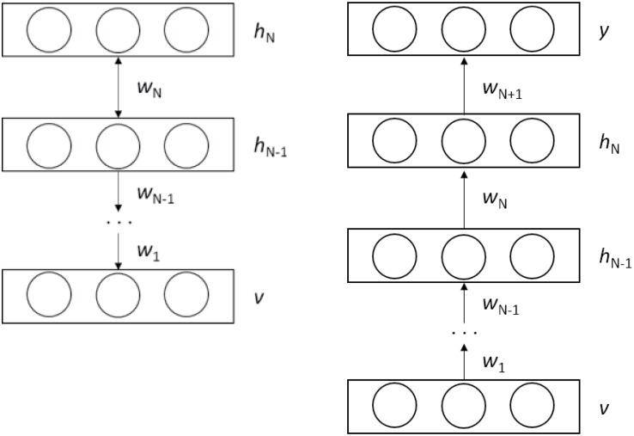
Notes:
In this top-down manner, the weight vector wn is generated to form the visible data vector v, and the set of wn is used for initializing the parameters of the proposed classifiers later.
Using DBN after getting the weights, we apply them in DNN to get the desired binary output.

Slide 7
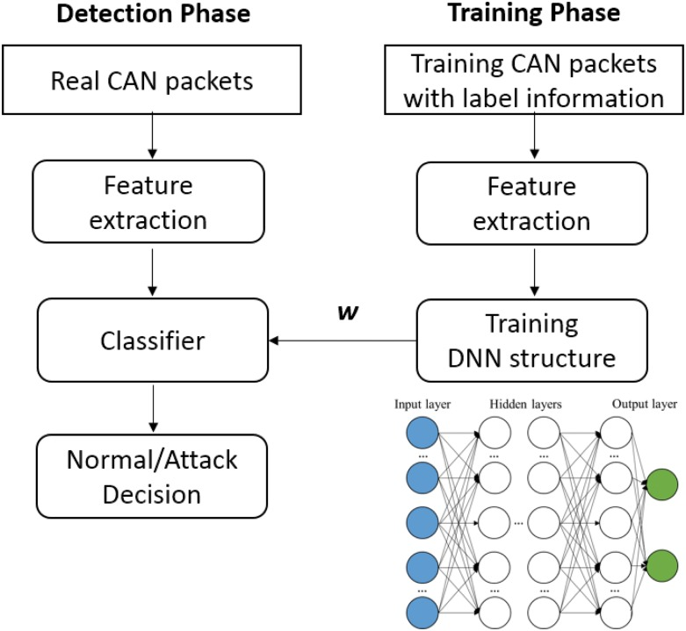
Notes:
Our IDS design consists of two main phases, i.e., the training phase and the detection phase as in the conventional machine-learning based IDS
The training phase is performed off-line as the training is time-consuming. In the training phase a CAN packet is processed to extract a feature that represents a statistical behavior of the network

Slide 8
CAN Packet Feature
CAN feature is an abstract representation of a CAN packet
po = {P(b0), P(b0), …, P(b63)}
The dimension can be reduced by considering specific semantics in the corresponding syntax element
The proposed technique regards mode information and value information according to the semantics
Notes:
where P(bi) is the probability of a bit-symbol “1” observed in the i-th bit position,
All the bit positions in the DATA field may be used for generating the feature.
The mode information represents a command state of an ECU, for example, controlling wheels, and the value information represents the value of the mode, for example, the wheel angle or the speed

Slide 9
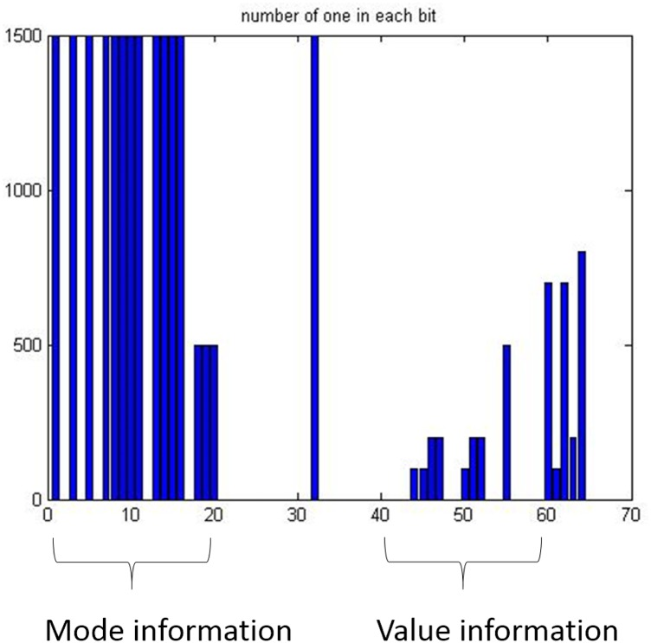
Notes:
The occurrences of a bit-symbol “1” in the DATA field of 8 Bytes, consisting of mode information and value information, at time t.
Denote pv is the data vector reduced from p. Then the feature vector v at time instance n is generated as v(n) = pv(n) ⊕ pv(n - 1)

Slide 10
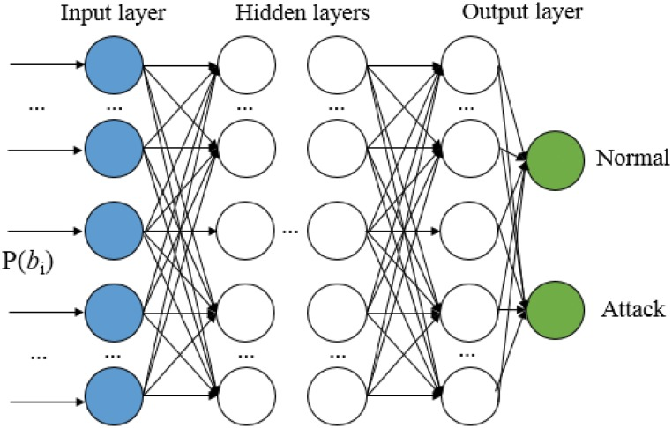
Training the Deep Neural Network Structure
Notes:
The learning mechanism of the proposed DNN structure to classify a normal packet and an attack packet is explained
Figure shows an input layer, multiple hidden layers, and an output layer
The feature vector is inputted to the input nodes of the structure. Each node in Fig computes an output with an activation function using rectified linear unit (ReLU), and the linear combinations of the outputs are linked to the next hidden layers.

Slide 11
Steps to Perform DNN
Expressing the Cost Function (mean squared error function)
C(w; v, y) = ½ ∥ hw(v) - y∥2,
Determining the overall Cost Value for batch Training
C(w)=1K∑kC(w;vk,yk)+λ2∑nN∑iMl∑jMl+1(wjin)2,
Minimizing the Cost Function using Gradient Method
w*=argminwC(w)
wjin=wjin-1+ζ∂∂wjin-1C(w), where ζ is an adaptation parameter.
Notes:
where N is the depth of the neural network, Ml is the number of the nodes in the l-th layer, and wjin∈w is the weight of the edges between a node i in the layer n − 1 and a node j in the layer n.
We want to obtain the optimal parameter set w* to achieve the minimization of the objective function using backpropagation algorithm.
In the back propagation algorithm the weight vectors are updated from the top layer to the bottom layer by using the stochastic gradient method.

Slide 12
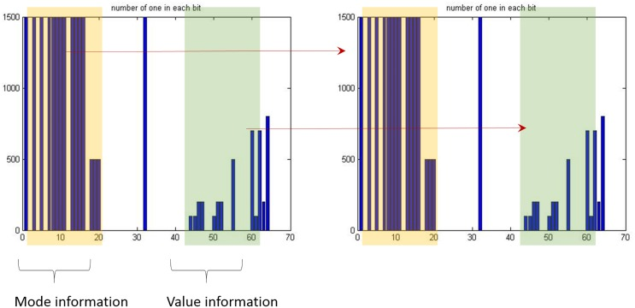
Attack Detection
Notes:
The class of a testing CAN packet is predicted in the detection phase. The output is computed with the trained weight parameters and the feature set extracted from the testing CAN packet as in the training. The classifier provides the logistic value 0 or 1, telling if the sample is normal packet or the attack packet, respectively.
There can be a number of attack scenarios considered in an ECU, and the weight vectors can be trained fitted to each scenario. The mode information is used for identifying the scenario in the proposed method, so that the appropriate training set can be applied. For this, template matching is developed in the proposed method. The template comprising the mode information refers to the information along with the training samples used for the specific scenario. Figure shows an example of the template matching where the template is colored with yellow. As shown, if the template is matched between in the training sample and in the CAN packet to be tested, the detector uses the corresponding trained parameters obtained from the value information.

Slide 13
References
Intrusion Detection System Using Deep Neural Network for In-Vehicle Network Security
By: Min-Joo Kang and Je-Won Kang*

